Slide 1

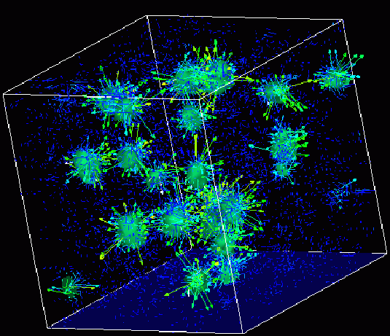
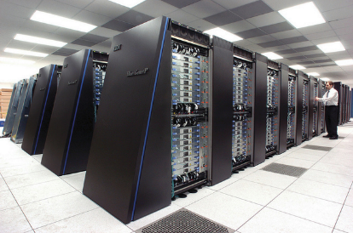
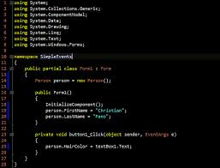
Survey of
Scientific Computing
(SciComp 301)
Dave Biersach
Brookhaven National Laboratory
dbiersach@bnl.gov
Session 10
Matrix Algebra,
Number Theory

Slide 2
Session Goals
Learn how to declare and define a 2D matrix in C++
Implement a function to perform matrix multiplication
Develop recursive code to calculate the determinant of a 2D matrix of any size
Implement Cramer’s rule to solve a system of linear solutions
Verify Goldbach’s Conjecture within a given range by developing a vector of primes

Slide 3
Matrices
A “matrix” in C++ is represented as a vector of vectors
A matrix can hold any number of elements (in each dimension) but all elements must be of the same data type, such as int or double
Matrix elements are accessed by their index numbers, which starts at zero and correspond to each dimension
Matrix nomenclature
In mathematics, a matrix size is written as (Rows x Columns)
In older C++ code a matrix (aka an array) is written using commas instead of multiplication crosses, and using square brackets instead of parenthesis: [Row][Column]
An example older C++ array is [5][7] which has 5 rows and 7 columns

Slide 4
Matrix Multiplication
When rendering computer graphics, we often need to find the product of two matrices, e.g.
$$\left(\begin{matrix}4 & 5 & 8 \\ 1 & 9 & 7\end{matrix}\right)⋅\left(\begin{matrix}2 & 4 \\ 6 & 1 \\ 5 & 9\end{matrix}\right)= ?$$
There is a standard algorithm to do this multiplication
It involves multiplying each element in the rows of first matrix by each element in the columns of the second matrix

Slide 5
Matrix Multiplication
In order to multiply two matrices together, the number of columns in matrix A must equal the number of rows in matrix B (Cols A = Rows B)
The resulting matrix will have as many rows as there were rows in matrix A, and as many columns as there were columns in matrix B (Rows A x Cols B)

Slide 6
Matrix Multiplication
Example
Matrix A has dimension (2 x 3) = 2 rows, 3 columns
Matrix B has dimension (3 x 2) = 3 rows, 2 columns
$$\left(\begin{matrix}4 & 5 & 8 \\ 1 & 9 & 7\end{matrix}\right)⋅\left(\begin{matrix}2 & 4 \\ 6 & 1 \\ 5 & 9\end{matrix}\right)= ?$$
The inner values must match!
(2 x 3) • (3 x 2)
The outer values will be
the dimension of the final
matrix product!

Slide 7
Matrix Multiplication
Matrix multiplication is not commutative!
If we multiple A x B we will get a different matrix than if we multiply B x A
(3 x 2) • (2 x 3) = result is a (3 x 3) matrix
(2 x 3) • (3 x 2) = result is a (2 x 2) matrix
Welcome to the world of non-commutative algebra
This is very strange – it catches even great physicists by surprise!
This asymmetry is the foundation of the matrix formulation of quantum mechanics

Slide 8
Matrix Multiplication
The algorithm is simple but tedious for A x B = C
Sum the product of every element in each row of matrix A and the corresponding element in each column of matrix B
That sum becomes just one element in new matrix C
Continue this process for all rows in matrix A
Every row in A gets multiplied by every column in B
The resulting matrix will have dimensions (Rows A x Cols B)

Slide 9
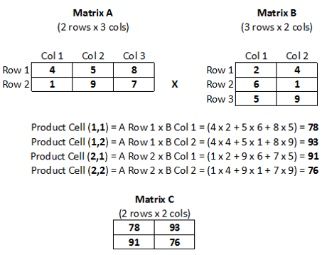
Matrix Multiplication

Slide 10
Matrix Multiplication

Slide 11
Matrix Multiplication

Slide 12
Matrix Multiplication

Slide 13
Matrix Multiplication

Slide 14
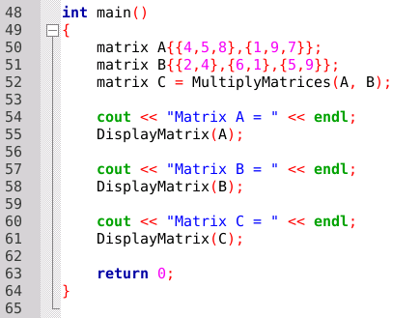
Open Lab 1 – Matrix Multiply
Review the key functions main(), DisplayMatrix(), and MultiplyMatrices()
The code will display the product matrix in row, col format
We can define matrices using the consistent C++ value initialization syntax

Slide 15
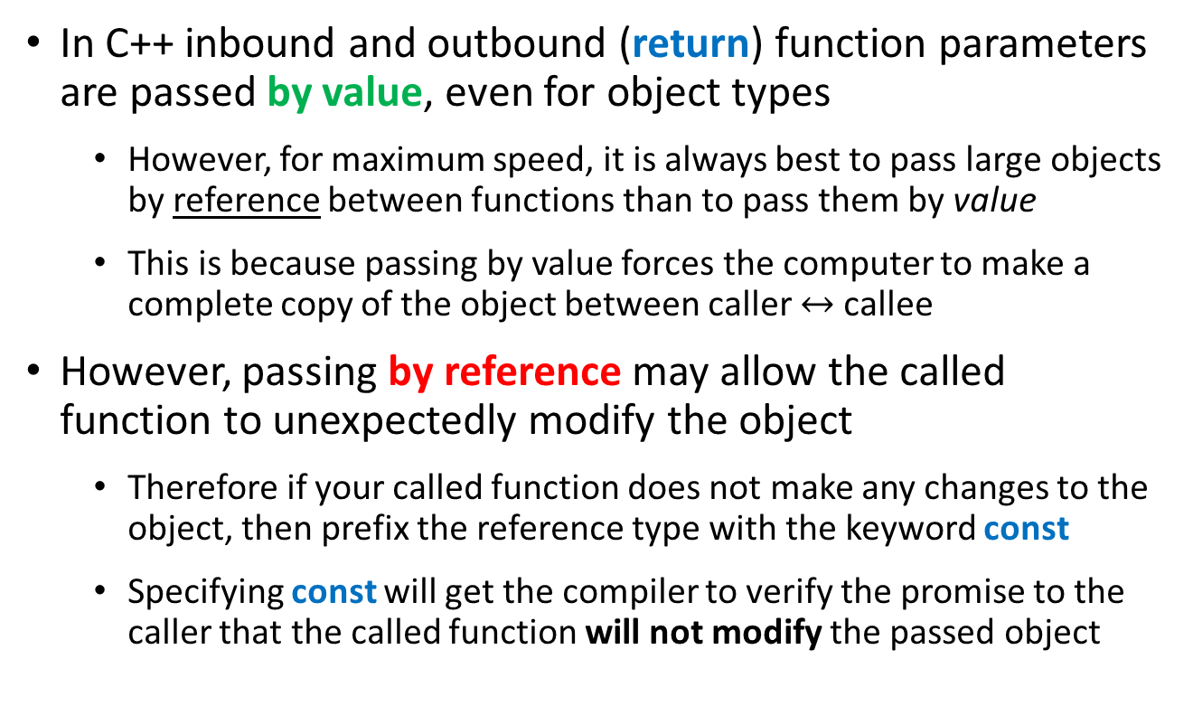
Passing Objects To/From Functions in C++
In C++ inbound and outbound (return) function parameters are passed by value, even for object types
However, for maximum speed, it is always best to pass large objects by reference between functions than to pass them by value
This is because passing by value forces the computer to make a complete copy of the object between caller $↔$ callee
However, passing by reference may allow the called function to unexpectedly modify the object
Therefore if your called function does not make any changes to the object, then prefix the reference type with the keyword const
Specifying const will get the compiler to verify the promise to the caller that the called function will not modify the passed object

Slide 16
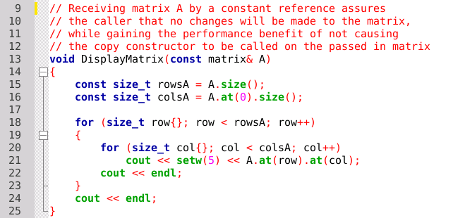
Lab 1 – Matrix Multiply
Matrix A is received as a constant reference
(const matrix&)
Declaring function parameters as const & is a promise your function will not modify the variable passed to it

Slide 17
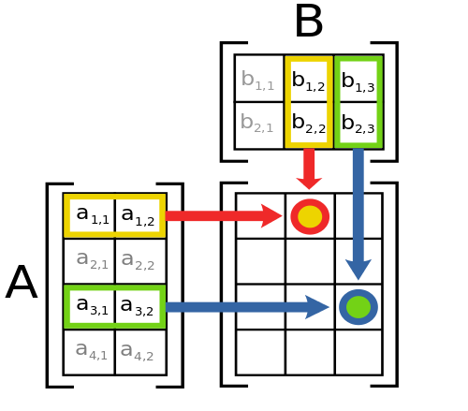
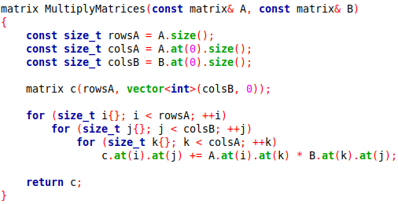
Lab 1 – Matrix Multiply
C++ uses copy elision (rhymes with decision) to avoid duplicating an entire object when returning to the caller
C++ implements RVO (return value optimization) where locally scoped variables can be returned directly to the caller without having to be copied

Slide 18
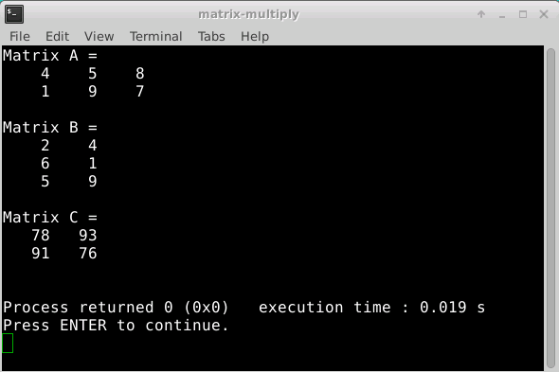
Run Lab 1 – Matrix Multiply

Slide 19
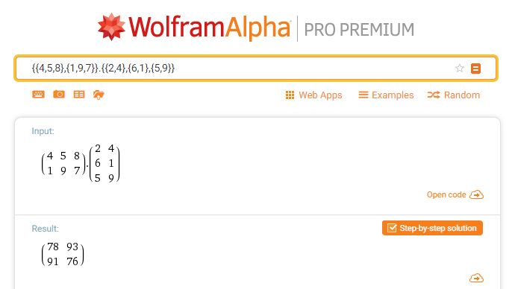
Check Lab 1 - Matrix Multiply

Slide 20

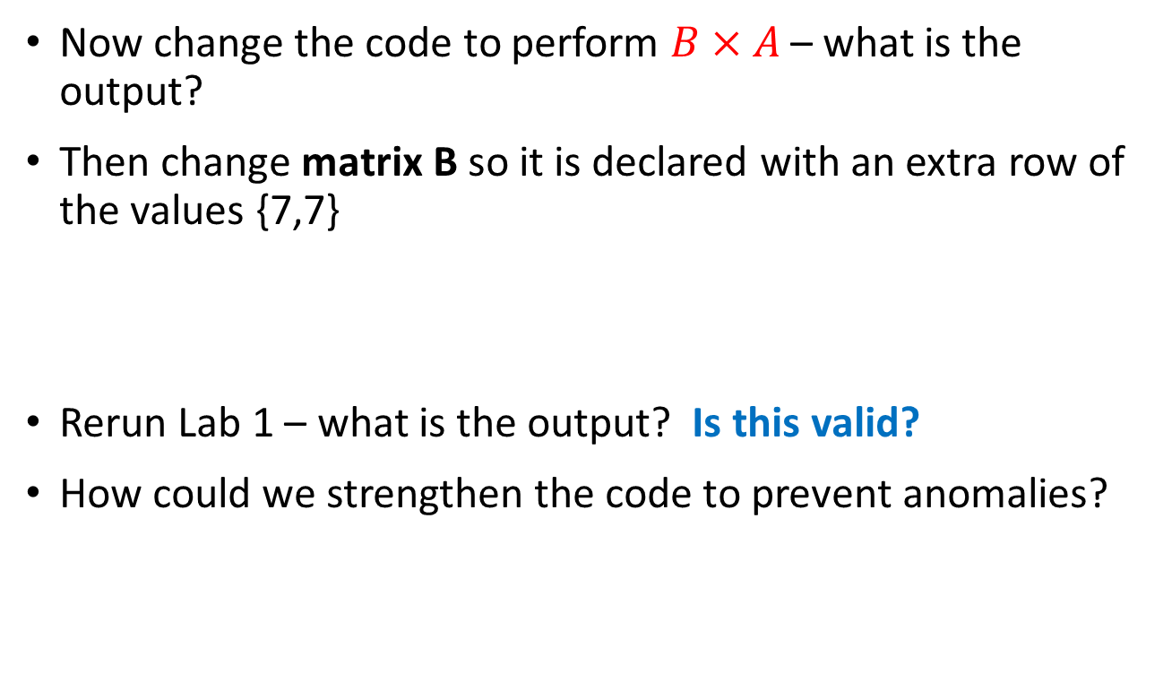
Edit Lab 1 – Matrix Multiply
Now change the code to perform $B×A$ – what is the output?
Then change matrix B so it is declared with an extra row of the values {7,7}
Rerun Lab 1 – what is the output? Is this valid?
How could we strengthen the code to prevent anomalies?

Slide 21
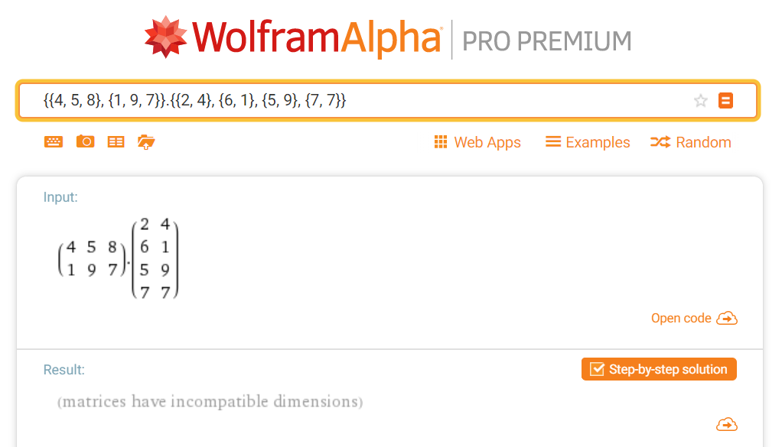

Check Lab 1 – Matrix Multiply
$$\left(2×3\right)∗\left(4×2\right)$$

Slide 22
Determinant of a Matrix
In linear algebra, the determinant is a value that can be computed from the elements of a square matrix
The determinant can be used:
To solve a system of linear equations when those equations are represented by a matrix
To find the Jacobian of the matrix of all first-order partial derivatives of a vector-valued function
To calculate the characteristic polynomial of a matrix which is essential for eigenvalue problems
To express the signed n-dimensional volumes of n-dimensional parallelepipeds in analytic geometry

Slide 23
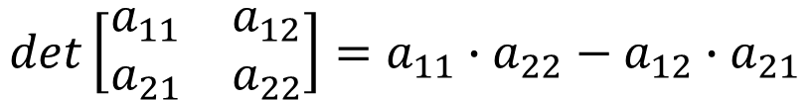
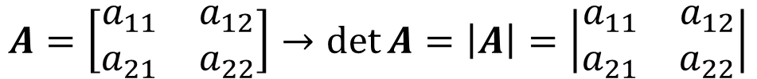
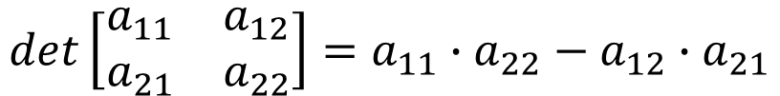
Determinant of a Matrix
Calculating the Determinant of a 2 x 2 Matrix
$$A=\left[\begin{matrix}a_{11} & a_{12} \\ a_{21} & a_{22}\end{matrix}\right]→\det{A}=\left|A\right|=\left|\begin{matrix}a_{11} & a_{12} \\ a_{21} & a_{22}\end{matrix}\right|$$
$$det\left[\begin{matrix}a_{11} & a_{12} \\ a_{21} & a_{22}\end{matrix}\right]=a_{11}∙a_{22}−a_{12}∙a_{21}$$
$$det\left[\begin{matrix}a_{11} & a_{12} \\ a_{21} & a_{22}\end{matrix}\right]=a_{11}∙a_{22}−a_{12}∙a_{21}$$

Slide 24
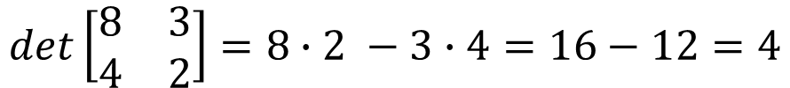
Determinant of a Matrix
Calculating the Determinant of a 2 x 2 Matrix
$$A=\left[\begin{matrix}a_{11} & a_{12} \\ a_{21} & a_{22}\end{matrix}\right]→\det{A}=\left|A\right|=\left|\begin{matrix}a_{11} & a_{12} \\ a_{21} & a_{22}\end{matrix}\right|$$
$$det\left[\begin{matrix}a_{11} & a_{12} \\ a_{21} & a_{22}\end{matrix}\right]=a_{11}∙a_{22}−a_{12}∙a_{21}$$
$$det\left[\begin{matrix}8 & 3 \\ 4 & 2\end{matrix}\right]=8∙2 −3∙4=16−12=4$$

Slide 25
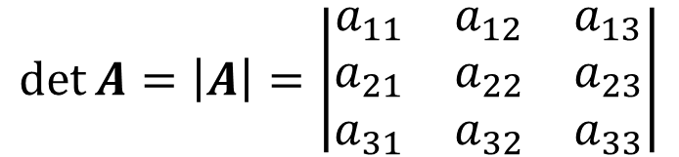
Determinant of a Matrix
Calculating the Determinant of a 3 x 3 Matrix
$$\det{A}=\left|A\right|=\left|\begin{matrix}a_{11} & a_{12} & a_{13} \\ a_{21} & a_{22} & a_{23} \\ a_{31} & a_{32} & a_{33}\end{matrix}\right|$$
$$\left|A\right|=a_{11}\left|\begin{matrix}a_{22} & a_{23} \\ a_{32} & a_{33}\end{matrix}\right|−a_{21}\left|\begin{matrix}a_{12} & a_{13} \\ a_{32} & a_{33}\end{matrix}\right|+a_{31}\left|\begin{matrix}a_{12} & a_{13} \\ a_{22} & a_{23}\end{matrix}\right|$$

Slide 26
Determinant of a Matrix
Calculating the Determinant of a 3 x 3 Matrix
$$\det{A}=\left|A\right|=\left|\begin{matrix}a_{11} & a_{12} & a_{13} \\ a_{21} & a_{22} & a_{23} \\ a_{31} & a_{32} & a_{33}\end{matrix}\right|$$
$$\left|A\right|=a_{11}\left|\begin{matrix}a_{22} & a_{23} \\ a_{32} & a_{33}\end{matrix}\right|−a_{21}\left|\begin{matrix}a_{12} & a_{13} \\ a_{32} & a_{33}\end{matrix}\right|+a_{31}\left|\begin{matrix}a_{12} & a_{13} \\ a_{22} & a_{23}\end{matrix}\right|$$

Slide 27
Determinant of a Matrix
Calculating the Determinant of a 3 x 3 Matrix
$$\det{A}=\left|A\right|=\left|\begin{matrix}a_{11} & a_{12} & a_{13} \\ a_{21} & a_{22} & a_{23} \\ a_{31} & a_{32} & a_{33}\end{matrix}\right|$$
$$\left|A\right|=a_{11}\left|\begin{matrix}a_{22} & a_{23} \\ a_{32} & a_{33}\end{matrix}\right|−a_{21}\left|\begin{matrix}a_{12} & a_{13} \\ a_{32} & a_{33}\end{matrix}\right|+a_{31}\left|\begin{matrix}a_{12} & a_{13} \\ a_{22} & a_{23}\end{matrix}\right|$$

Slide 28
Determinant of a Matrix
Calculating the Determinant of a 3 x 3 Matrix
$$\det{A}=\left|A\right|=\left|\begin{matrix}a_{11} & a_{12} & a_{13} \\ a_{21} & a_{22} & a_{23} \\ a_{31} & a_{32} & a_{33}\end{matrix}\right|$$
$$\left|A\right|=a_{11}\left|\begin{matrix}a_{22} & a_{23} \\ a_{32} & a_{33}\end{matrix}\right|−a_{21}\left|\begin{matrix}a_{12} & a_{13} \\ a_{32} & a_{33}\end{matrix}\right|+a_{31}\left|\begin{matrix}a_{12} & a_{13} \\ a_{22} & a_{23}\end{matrix}\right|$$

Slide 29
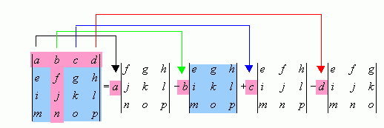
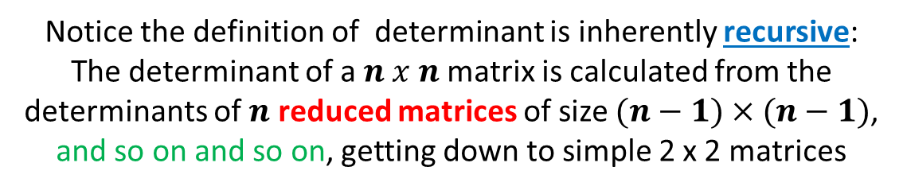
Determinant of a Matrix
Calculating the Determinant of a 4 x 4 Matrix
Notice the definition of determinant is inherently recursive:
The determinant of a $n x n$matrix is calculated from the determinants of $n$ reduced matrices of size $(n−1)×(n−1)$,
and so on and so on, getting down to simple 2 x 2 matrices

Slide 30

Open Lab 2 – Matrix Determinant
Your scientist wants you to write a program to calculate the determinant of a 10 x 10 matrix
Each element in the matrix should be a uniform random integer between -10 and 10 inclusively
Implement the matrix as a C++ vector of vectors
These type aliases declare the same structure

Slide 31
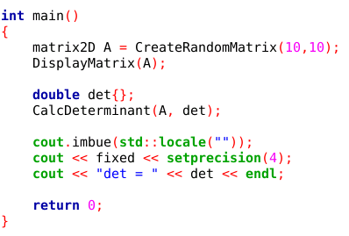
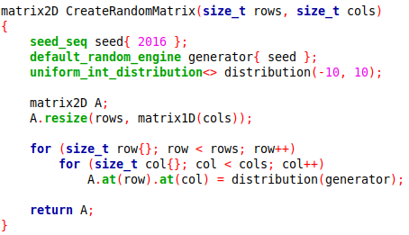
View Lab 2 – Matrix Determinant

Slide 32
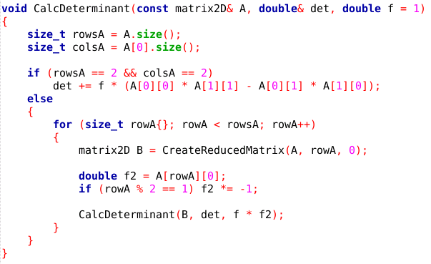
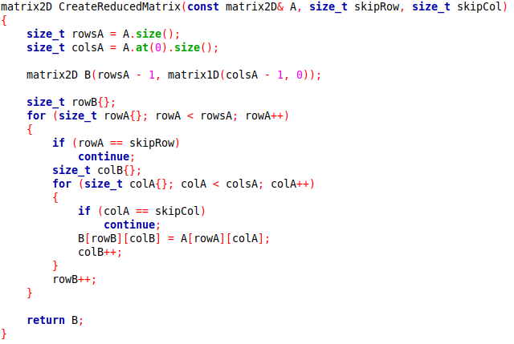
View Lab 2 – Matrix Determinant

Slide 33
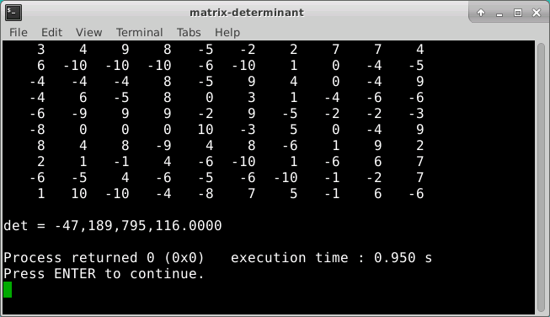
Run Lab 2 – Matrix Determinant

Slide 34
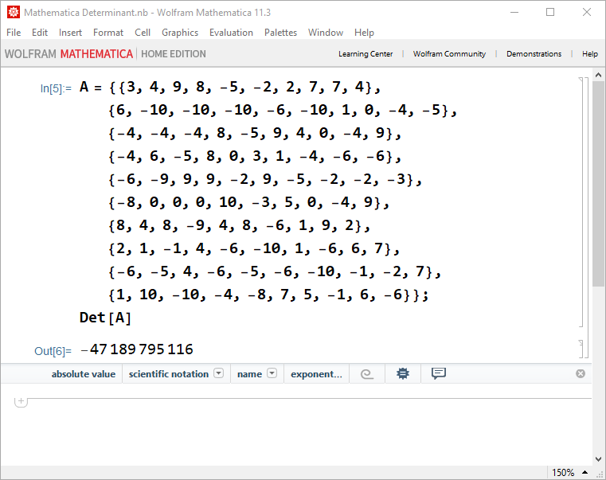
Check Lab 2 – Matrix Determinant

Slide 35








Goal: Solve a System of Linear Equations
Two Equations and Two Unknowns
$$ax+by=c$$
$$dx+ey=f$$
$$ax=c−by$$
$$\frac{d(c−by)}{a}+ey=f$$
$$x=\frac{c−by}{a}$$
$$cd−bdy+aey=af$$
$$y\left(ae−bd\right)=af−cd$$
$$y=\frac{af−cd}{ae−bd}$$

Slide 36





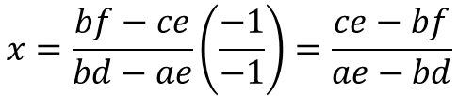
Goal: Solve a System of Linear Equations
Two Equations and Two Unknowns
$$ax+by=c$$
$$dx+ey=f$$
$$by=c−ax$$
$$dx+\frac{e(c−ax)}{b}=f$$
$$y=\frac{c−ax}{b}$$
$$bdx+ce−aex=bf$$
$$x\left(bd−ae\right)=bf−ce$$
$$x=\frac{bf−ce}{bd−ae}\left(\frac{−1}{−1}\right)=\frac{ce−bf}{ae−bd}$$

Slide 37





Goal: Solve a System of Linear Equations
Two Equations and Two Unknowns
$$ax+by=c$$
$$dx+ey=f$$
$$x=\frac{ce−bf}{ae−bd}$$
$$y=\frac{af−cd}{ae−bd}$$
$$\det{C=\left|\begin{matrix}a & b \\ d & e\end{matrix}\right|=ae−bd}$$

Slide 38

Goal: Solve a System of Linear Equations
Two Equations and Two Unknowns
$$ax+by=c$$
$$dx+ey=f$$
$$\det{A=\left|\begin{matrix}c & b \\ f & e\end{matrix}\right|=ce−bf}$$
$$x=\frac{ce−bf}{ae−bd}$$
$$y=\frac{af−cd}{ae−bd}$$
$$\det{C=\left|\begin{matrix}a & b \\ d & e\end{matrix}\right|=ae−bd}$$

Slide 39

Goal: Solve a System of Linear Equations
Two Equations and Two Unknowns
$$ax+by=c$$
$$dx+ey=f$$
$$\det{A=\left|\begin{matrix}c & b \\ f & e\end{matrix}\right|=ce−bf}$$
$$x=\frac{ce−bf}{ae−bd}$$
$$\det{B=\left|\begin{matrix}a & c \\ d & f\end{matrix}\right|=af−cd}$$
$$y=\frac{af−cd}{ae−bd}$$
$$\det{C=\left|\begin{matrix}a & b \\ d & e\end{matrix}\right|=ae−bd}$$

Slide 40


Goal: Solve a System of Linear Equations
Two Equations and Two Unknowns
$$ax+by=c$$
$$dx+ey=f$$
$$\det{A=\left|\begin{matrix}c & b \\ f & e\end{matrix}\right|=ce−bf}$$
$$x=\frac{ce−bf}{ae−bd}$$
$$x=\frac{\left|A\right|}{\left|C\right|}$$
$$\det{B=\left|\begin{matrix}a & c \\ d & f\end{matrix}\right|=af−cd}$$
$$y=\frac{af−cd}{ae−bd}$$
$$y=\frac{\left|B\right|}{\left|C\right|}$$
$$\det{C=\left|\begin{matrix}a & b \\ d & e\end{matrix}\right|=ae−bd}$$

Slide 41
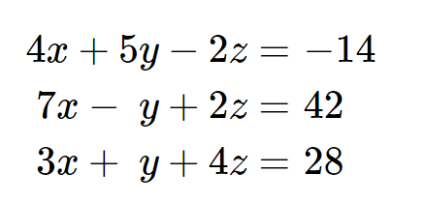
Goal: Solve a System of Linear Equations
Three Equations and Three Unknowns

Slide 42
Open Lab 3 – Cramer’s Rule
Develop a console mode C++ application that uses Cramer’s Rule to solve a system of three linear equations with three unknowns
The code encodes the system of equations as a 2D coefficient matrix and value vector (a 1D array)
The code already handles linearly dependent systems
The code will display the equations using standard algebraic formatting rules (aka “pretty print”)
No coefficients of 1, such as 1x + 5y + 32z = 49
No plus signed followed by a negative sign, such as 2x + -5y + 9 = -13
Don’t display an unknown if that term’s coefficient is 0

Slide 43
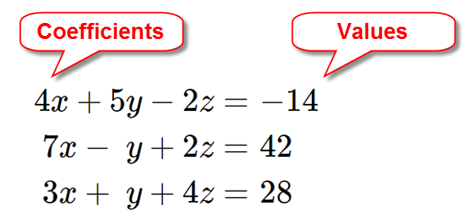
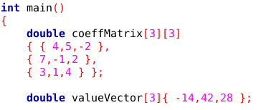
Create a Coefficient Matrix & Value Vector
NOTE: This is the old school way of specifying 2D arrays

Slide 44
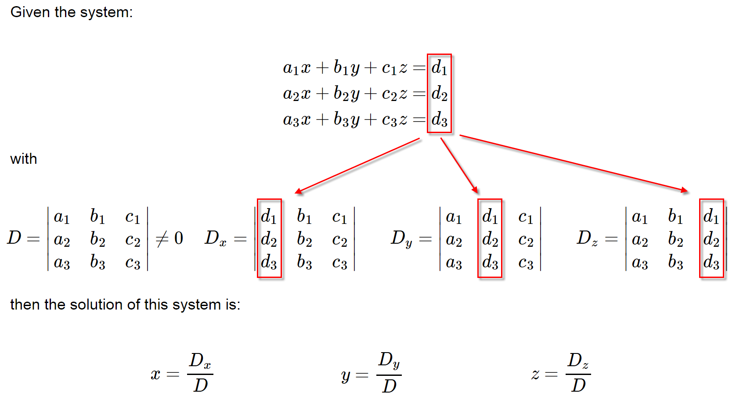
Cramer’s Rule

Slide 45
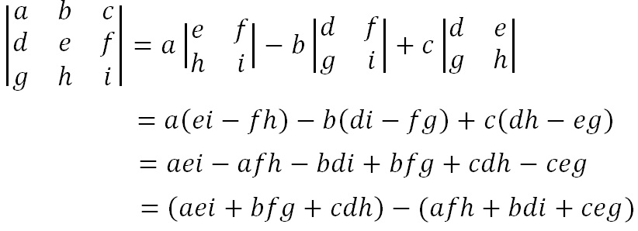
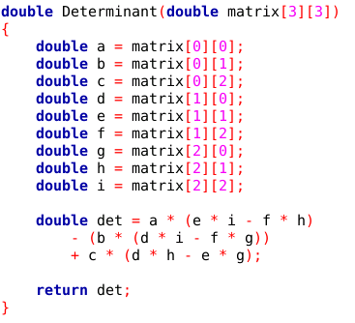
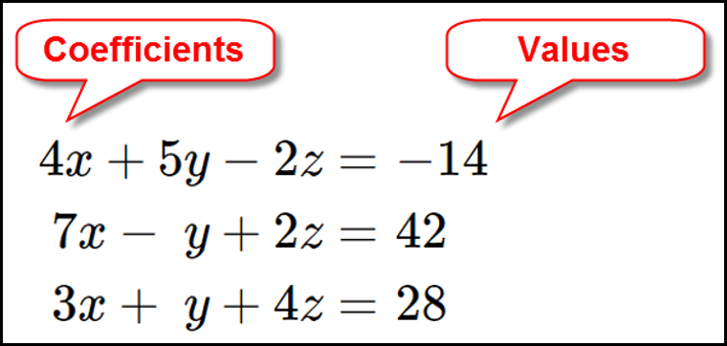
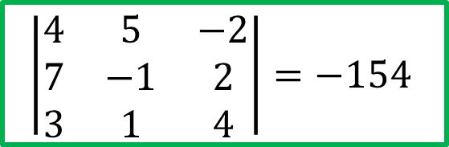
Cramer’s Rule
Calculating the Determinant of a 3 x 3 Matrix
$$\left|\begin{matrix}4 & 5 & −2 \\ 7 & −1 & 2 \\ 3 & 1 & 4\end{matrix}\right|=−154$$
Coefficient Matrix

Slide 46
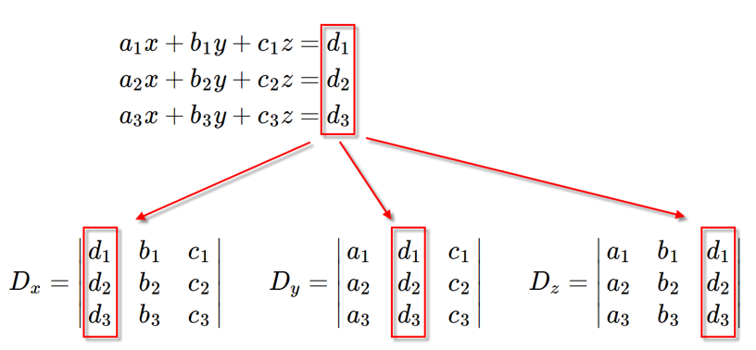
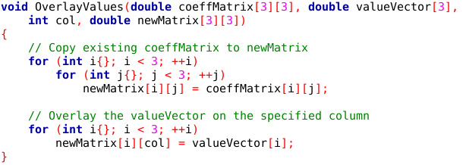
Cramer’s Rule
Overlay the values onto the coeffMatrix

Slide 47
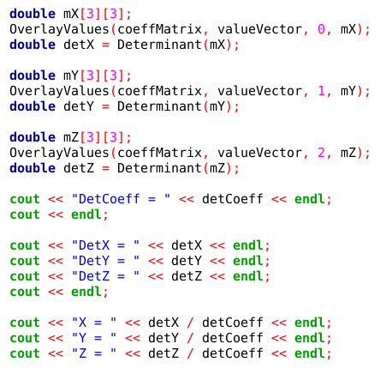
Cramer’s Rule
Create new matrices mX, mY, mZ

Slide 48
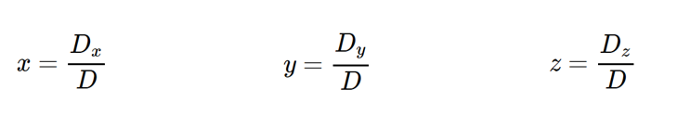
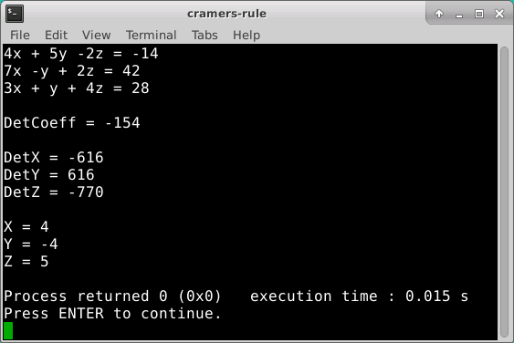
Run Lab 3 - Cramer’s Rule
What does it mean if D = 0?

Slide 49
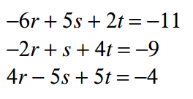
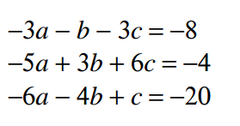
Edit Lab 3 – Cramer’s Rule
Update the main() function to solve these two systems of linear equations:

Slide 50
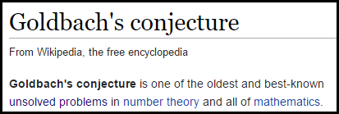
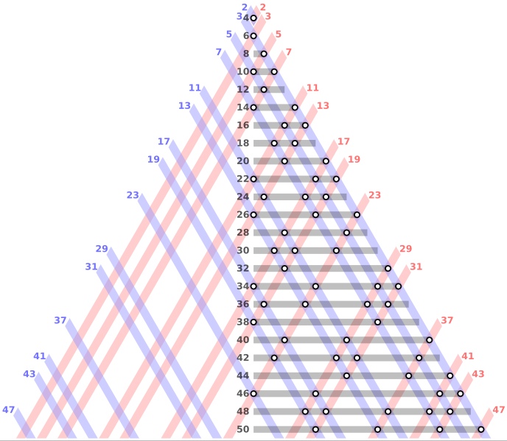

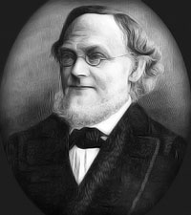
Goldbach’s Conjecture
Every even integer greater than 4 can be written as the sum of two odd primes!

Slide 51
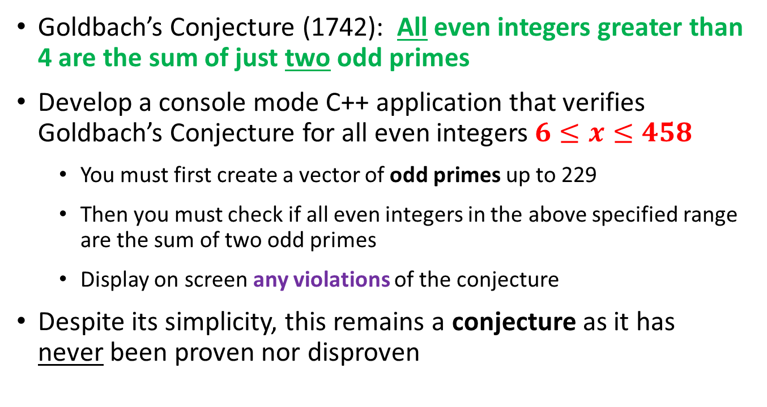
Open Lab 4 – Goldbach’s Conjecture
Goldbach’s Conjecture (1742): All even integers greater than 4 are the sum of just two odd primes
Develop a console mode C++ application that verifies Goldbach’s Conjecture for all even integers $6≤x≤458$
You must first create a vector of odd primes up to 229
Then you must check if all even integers in the above specified range are the sum of two odd primes
Display on screen any violations of the conjecture
Despite its simplicity, this remains a conjecture as it has never been proven nor disproven

Slide 52
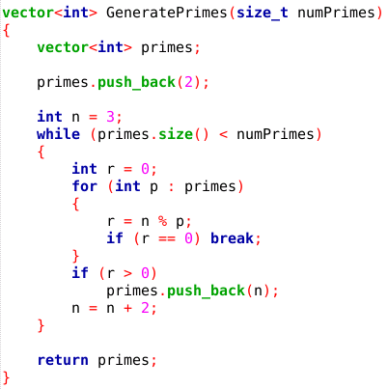
Lab 4 Goldbach’s Conjecture

Slide 53
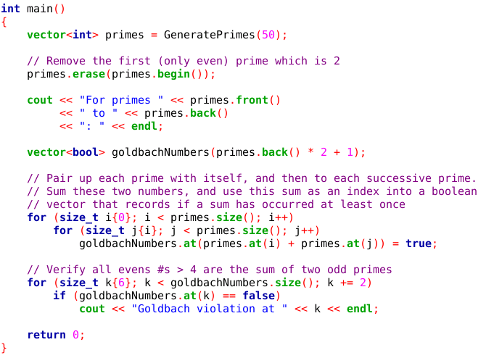
Lab 4 Goldbach’s Conjecture
Every even integer greater than 4 can be written as the sum of two odd primes!

Slide 54
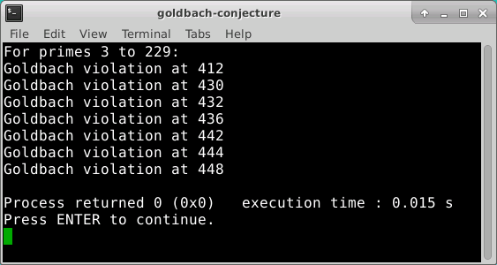
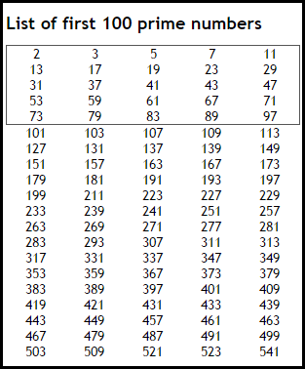


Run Lab 4 – Goldbach’s Conjecture
How can this be?
Where did we go wrong?
Verify for all even integers $6≤x≤458$

Slide 55


Goldbach’s Conjecture

Slide 56
Now you know…
To multiply two matrices, the # of columns in the first matrix must match the # of rows in the second matrix
The product matrix will have the same # of rows as the first matrix, and the same # of columns as the second matrix
Matrix multiplication is the sum of the element by element products of the rows in the first matrix and the columns in the second matrix
Cramer’s Rule is a step-by-step algorithmic way to solve systems of linear equations without the tedious algebra of back substitution – it uses determinants
This method is easy to run in parallel as each CPU core can calculate a separate unknown at the same time
Goldbach is waiting for you! ☺

